Slide 2

WEEKLY REPORT
WEEK 6 – ICN TRAINING
NGUYEN HAI DANG

Slide 3
What I have done this week
Learn about Recurrent Neural Networks (RNN)
Learn about stratified sampling and how it helps to effectively split a dataset into train-dev-test
Review on Convolutional Neural Networks and study its implementation.

Slide 4
I. Recurrent Neural Networks (RNNs)
Concept
A type of neural network that handles sequential data inputs.
While CNNs are mostly used to handle visual data inputs (spatial), RNNs can accept data in an ordered sequence (temporal)
Example: text, video, speech, time series, etc.
Implementation into real life: Text-to-speech (TTS), video recognition,
machine translation, sentiment classification

Slide 5
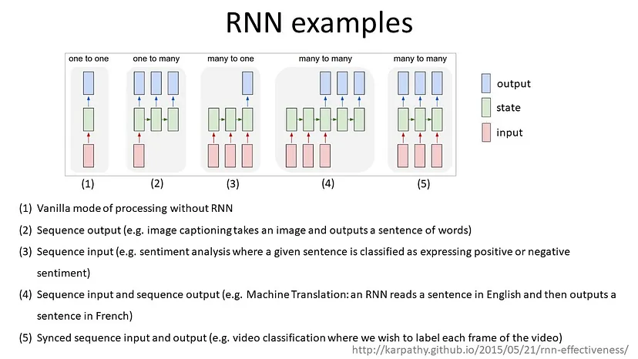
I. Recurrent Neural Networks (RNNs)
Types of recurrent neural networks

Slide 6
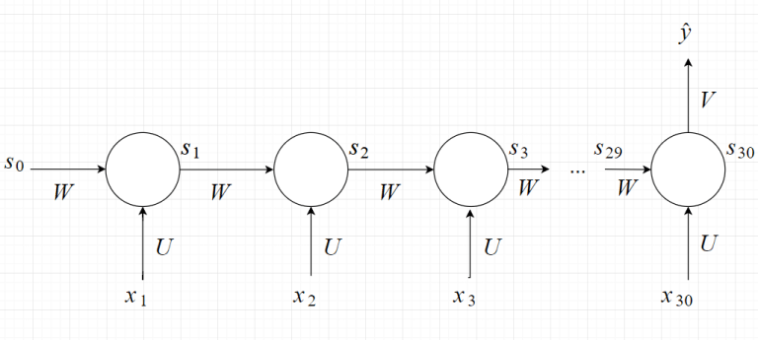
I. Recurrent Neural Networks (RNNs)
Example of a recurrent neural network
Problem: Behavior recognition with a 30s video
Many-to-one RNN
The input will be separated by 30 FPS; the images will pass through a CNN model for feature extraction to become vector x_{i} , where i represents the second of the video

Slide 7
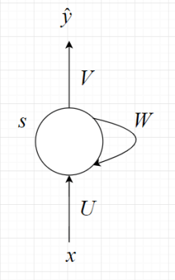
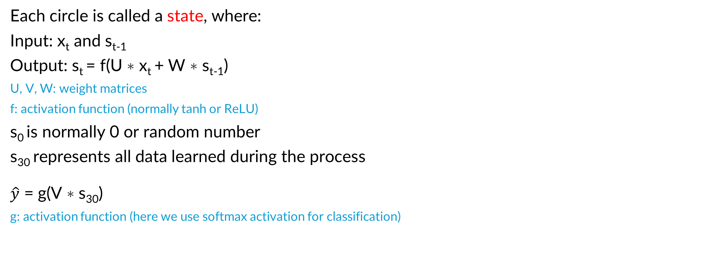
I. Recurrent Neural Networks (RNNs)
Each circle is called a state, where:
Input: x_{t} and s_{t-1}
Output: s_{t} = f(U ∗ x_{t} + W ∗ s_{t-1})
U, V, W: weight matrices
f: activation function (normally tanh or ReLU)
s₀ is normally 0 or random number
s₃₀ represents all data learned during the process
$\hat{y}$ = g(V ∗ s₃₀)
g: activation function (here we use softmax activation for classification)

Slide 8
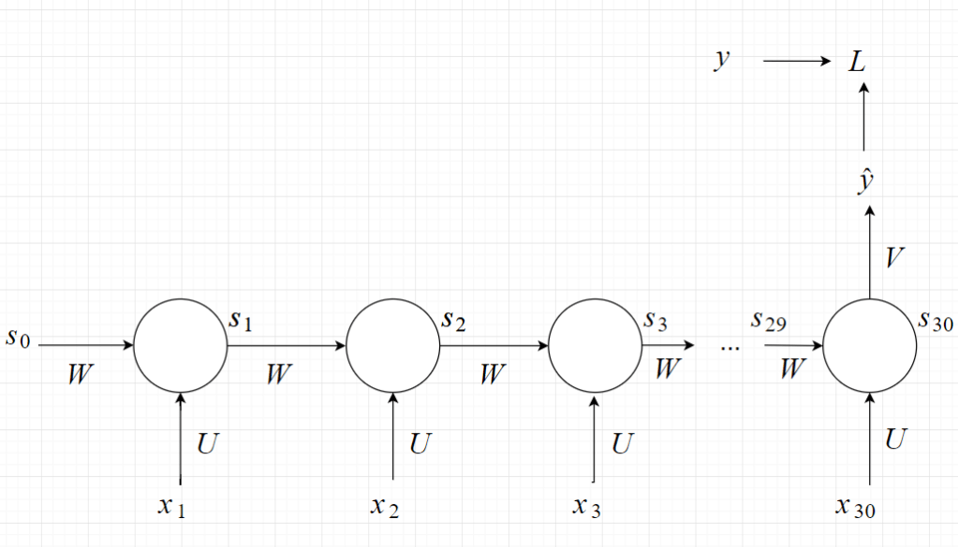
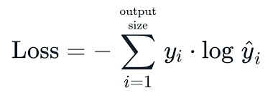
I. Recurrent Neural Networks (RNNs)
Loss function:
Here, we use the
categorical cross
-entropy for the
classification problem:
for each value in the output vector

Slide 9

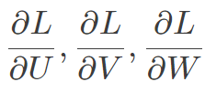
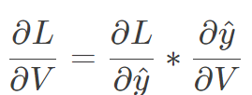






I. Recurrent Neural Networks (RNNs)
Backpropagation through time (BPTT): To use gradient descent, we need
to find
Derivation w.r.t V is simply calculated by:
w.r.t W (likewise for U):
, where (total differential) since
and s₂₉ depends on W.
Similarly, we can calculate: , where and
is the derivative of s_{i} w.r.t W when we consider s_{i-1} as a constant w.r.t W
Note: This method is conducive to vanishing gradient -> LSTM

Slide 10
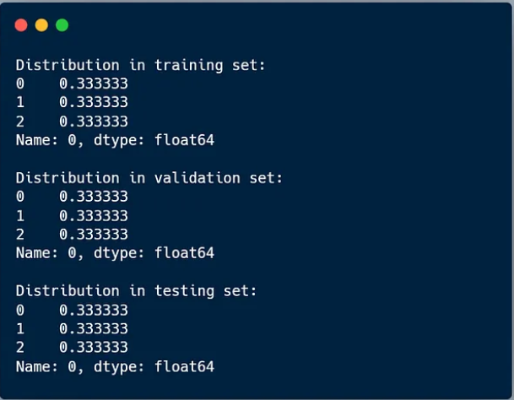
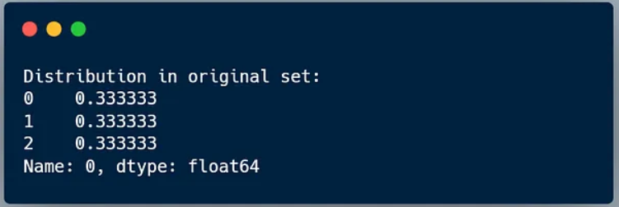
II. Stratified sampling
Concept
In training models, we may encounter small, imbalanced datasets with a lopsided distribution of categories. If we split the dataset in a totally random manner, the model might have prediction errors due to “biased” train-test-dev sets
-> We use stratified sampling to maintain the proportional distribution of categories within the train-test-dev sets.

Slide 11
II. Stratified sampling
Pros and cons
Pros:
+ Reduces bias in training data
+ Ensures the presence of all categories for the model to learn effectively
Cons:
+ Can be time-consuming and resource-demanding in cases of highly complex datasets (e.g: certain samples can fall into multiple categories)
+ Might cause overfitting due to excessive tuning.

Slide 12
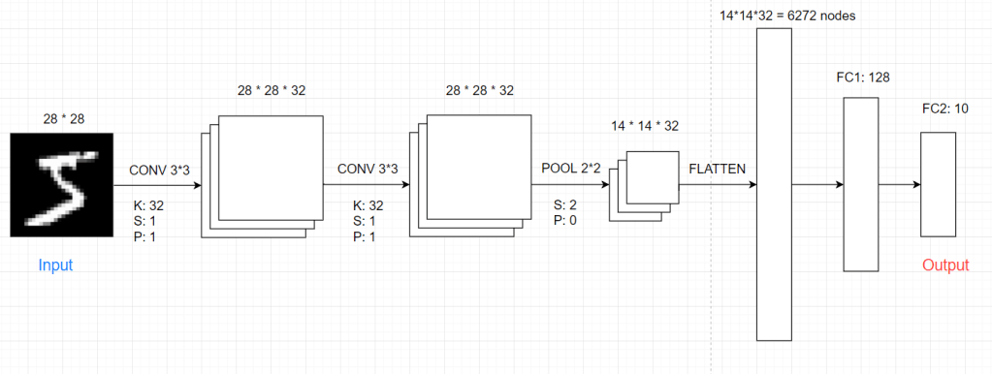
III. CNN implementation
Implementation with Keras on MNIST dataset

Slide 13
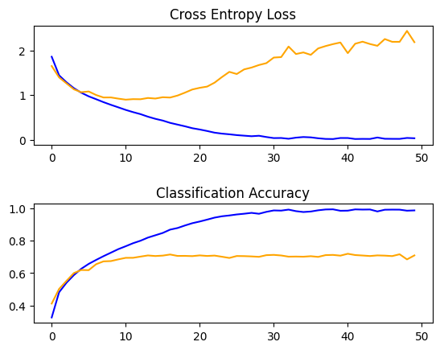
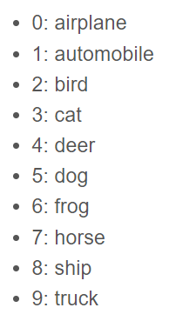
III. CNN implementation
Implementation with Keras on CIFAR10 dataset
Same idea, but with 3D input.
(32x32x3)
Dataset contains 50,000 samples in
training set and 10,000 samples in test
set.
Loss and accuracy with 50 epochs

Slide 14
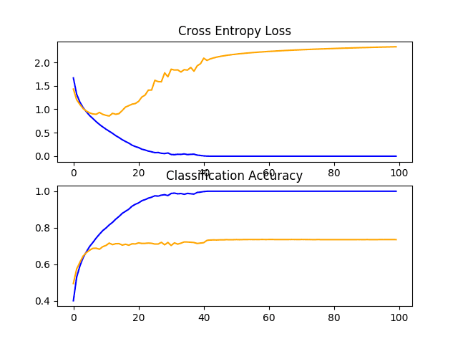


III. CNN implementation
underfit
overfit
overfit
underfit
Loss and accuracy with 100 epochs

Slide 15
THANK YOU !

